Slide 1
STEP 1 – DEFINE THE PROJECT
Is our app a need, or a want?

Slide 2
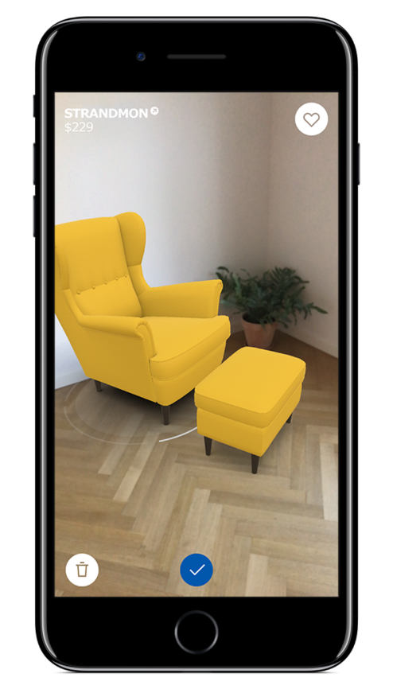
Step 1 Define the Project
Every application should exist to fix a real-world problem
Booking App for a Hair Salon
Product Catalogue for a Furniture Store
Food Delivery and Tracking App
Therefore every app has a mission
Clients can book on-the-move
Customers can browse at leisure
Customers can track their food

Slide 3
Step 1 Define the Project
This gives us a mission statement which should tell us what we want our finished product to do:
“To design and build an application that allows our customers to track their deliveries so that they may avoid waiting home for parcels”

